Slide 1
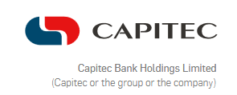
Capitec Bank Holdings Limited
Financial Performance & Ratio Analysis (2021–2025)

Slide 2

VISION & MISSION
Capitec’s vision is to be the most trusted brand in South Africa. We aim to make a meaningful difference in people’s lives, empowering them to grow. Our simple, accessible and affordable solutions, delivered with a personalized experience, ignite growth and unlock opportunities for individuals and businesses, helping them contribute to South Africa’s economy.

Slide 3



About this report
Financial Performance Context (2021-2025)
Integrated analysis and Interpretation
Financial Ratios

Slide 4
Financial Performance Context (2021-2025)
This presentation summarises Capitec Bank Holdings Limited's financial performance over the five-year period 2021–2025.
The analysis focuses on:
Profitability
Liquidity
Debt-equity position

Slide 5
Financial Ratios
The following financial ratios and liquidity measures were analysed:
Profitability:
Net Profit Margin
Return on Assets (ROA)
Return on Investment (ROI)
Liquidity:
Liquidity Coverage Ratio (LCR)
Net Stable Funding Ratio (NSFR)
Debt-equity:
Gearing Ratio

Slide 6
Profitability Ratios
Year | Net Profit Margin | Return on Assets | Return on Investment
2021 | 29.38% | 3.06% | 16%
2022 | 36.36% | 5.10% | 25.97%
2023 | 39.07% | 4.97% | 24.84%
2024 | 36.68% | 5.31% | 25.95%
2025 | 38.39% | 6.17% | 29.12%

Slide 7

Trend
Net profit margin increased significantly from 29.38% in 2021 to 38.39% in 2025.
The ratio reached its highest point of 39.07% in 2023, before declining slightly in 2024 and 2025.
Overall: All three profitability measures were higher in 2025 than in 2021.

Slide 8
Chart 1: 5-year profitability for Capitec Bank Holdings

Slide 9
Liquidity Position: 2021–2025
Banking-specific liquidity measures:
Measure | 2021 | 2025
Liquidity Coverage Ratio | 2.459% | 3.085%
Net Stable Funding Ratio | 221% | 225%
Key trend: Both measures remained substantially above the 100% regulatory requirement, indicating strong liquidity.

Slide 10
Gearing Ratio: 2021–2025
Year | Gearing
2021 | 423.20%
2022 | 397.47%
2023 | 402.74%
2024 | 376.82%
2025 | 368.32%

Slide 11
Chart 2: 5-Year Company’s Financial Leverage

Slide 12
Trend
Key trend: Gearing decreased overall from 423.20% to 368.32%.
Overall Performance
Profitability ↑
Liquidity ✓
Gearing ↓
Overall, Capitec demonstrated stronger financial performance in 2025 than in 2021.

Slide 13
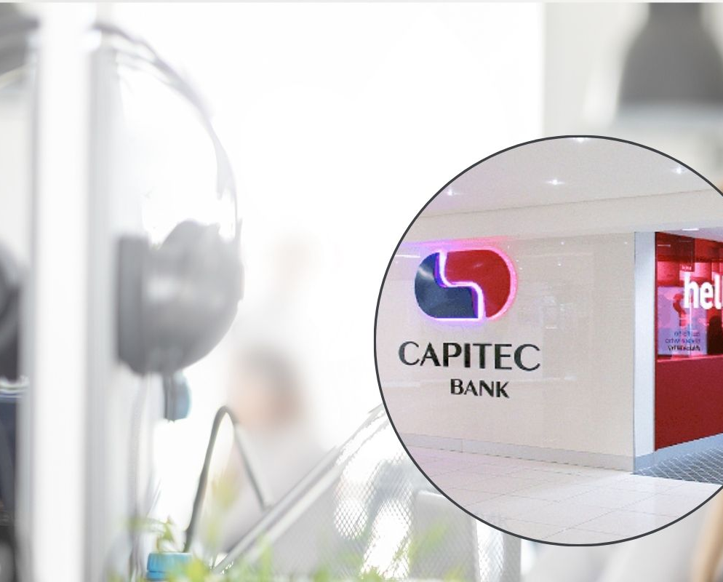

Conclusion
Between 2021 and 2025:
Profitability improved significantly.
Liquidity remained strong.
Gearing decreased overall.
Some fluctuations occurred during the period, but the overall financial trend was positive.
Capitec Bank Holdings Limited was financially stronger in 2025 than in 2021.
Thank You

